Slide 1


CAPSTONE PROJECT | PLANTRX
Plant Disease Detection System
PlantRx — Deep Learning-Based Leaf Disease Classification and Guidance
A browser-based first-level support tool for identifying supported leaf classes.
M.Sc. Applied Data Science
SRM Institute of Science and Technology
Om Desai (RA2532014010138)
Sanket Kurmi (RA2532014010156)
Abhirup Urinda (RA2532014010160)
Sourish Haldar (RA2532014010161)
Mentor : Dr. S.Sivakumar
(Associate Professor)
PLANT DISEASE DETECTION SYSTEM
01

Slide 2


ABSTRACT
PLANT RX | M.SC. APPLIED DATA SCIENCE
PlantRx AI helps address crop losses by detecting plant diseases from leaf images and recommending practical care. Using 54,284 PlantVillage images across 38 classes and 14 crops, we evaluated three pretrained models. MobileNetV2 achieved approximately 97% test accuracy and was selected for its speed and lightweight design; DenseNet121 achieved 94%, while EfficientNetB0 reached 85.76% on a smaller 22-class subset. Integrated with a remedy database, the React and FastAPI web app provides disease predictions, confidence scores, symptoms, treatment and prevention advice, weather-based tips, and FAQ support. PlantRx AI aims to help users act earlier and make more informed plant-care decisions.

Slide 3

PLANT RX | M.SC. APPLIED DATA SCIENCE
Introduction and Problem Statement
Why it matters
The difficulty
What PlantRx addresses
Leaf symptoms are often the first visible sign of a plant disease.
Knowing the likely disease early helps decide what to do next.
Manual visual checks can be subjective.
They depend on the observer’s experience.
Expert help is not always readily available.
Upload a leaf image.
Classify it into one of 38 supported classes.
Show related disease guidance.
Objective: connect image classification with accessible information, while making the limits of an automated prediction clear.
PlantRx is decision support, not a replacement for an agricultural expert.
PLANT DISEASE DETECTION SYSTEM
02

Slide 4
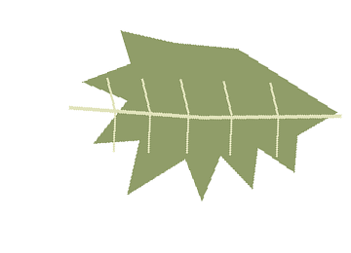
PLANT RX | M.SC. APPLIED DATA SCIENCE
Existing System vs Proposed System
Existing: manual visual inspection
Proposed: PlantRx workflow
Observer looks at the leaf
Result depends on experience
Diagnosis and advice may be separate
Hard without expert access
Upload a supported leaf image
Predict one of 38 known classes
Show confidence and top candidates
Display related guidance in one place
The system is limited to its trained classes and the quality of its reference data.
PLANT DISEASE DETECTION SYSTEM
03

Slide 5
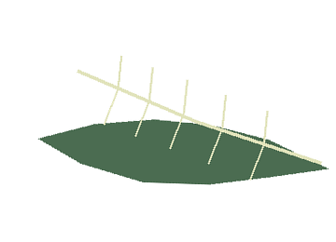
PLANT RX | M.SC. APPLIED DATA SCIENCE
Project Objectives
01 Explore the dataset
02 Train and compare models
Dataset exploration and EDA: class distribution, image dimensions and brightness.
Train and compare MobileNetV2, DenseNet121 and EfficientNetB0.
03 Apply transfer learning
04 Present results on a website
Use transfer learning on the labelled PlantVillage leaf dataset.
Show the predicted class and related disease guidance in a web interface.
The goal was a usable end-to-end concept, not a claim of perfect field diagnosis.
PLANT DISEASE DETECTION SYSTEM
04

Slide 6

SOURCE: CAPSTONE REPORT
Dataset Overview (PlantVillage Dataset)
54,284
38
14
37,982 / 8,126 / 8,176
images
classes
crop species
train / validation / test
Train / validation / test split (70 / 15 / 15)
70%
15%
15%
Training • 37,982
Validation • 8,126
Test • 8,176
The model learns patterns from these images.
Used to monitor progress and guide tuning during training.
Held-out images for the final evaluation.
The dataset contains 26 diseased classes and 12 healthy classes. Class sizes are uneven, so overall accuracy alone does not tell the whole story.
PLANT DISEASE DETECTION SYSTEM
05

Slide 7
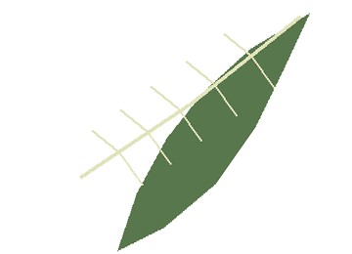
PLANT RX | M.SC. APPLIED DATA SCIENCE
Exploratory Data Analysis (EDA)
Class distribution
Tomato has 10 of the 38 classes; every other crop has 1 to 4.
Data imbalance
Tomato is heavily represented while some classes have far fewer examples, so minority classes are harder to learn.
Image size and brightness
Takeaway: about two-thirds of the 38 classes are diseased categories, and class sizes are uneven.
Inspected for variation across images. Numeric values are not reproduced on this slide.
PLANT DISEASE DETECTION SYSTEM
06

Slide 8

PLANT RX | M.SC. APPLIED DATA SCIENCE
Class Distribution by Crop
Takeaway
Classes are unevenly spread across crops.
Tomato has 10 classes, the most.
Five crops have just one class each.
Unknown diseases may be misclassified.
PLANT DISEASE DETECTION SYSTEM
07

Slide 9
PLANT RX | M.SC. APPLIED DATA SCIENCE
Plant Disease Detection Workflow
End-to-end process: from uploading a leaf image to displaying useful guidance
1
2
3
4
5
Upload leaf
image
Preprocess
image
Predict disease
class
Retrieve disease
guidance
Display
result
User uploads a leaf photo
and selects plant details
Resize, normalize and
prepare the image
MobileNetV2 analyses
visual leaf patterns
Find matching symptoms,
management and prevention
Show prediction, confidence
and top candidate classes
UPLOAD → PREPROCESS → PREDICT → RETRIEVE GUIDANCE → DISPLAY RESULT
The model provides a prediction to support assessment; it is not a guaranteed diagnosis.
PLANT DISEASE DETECTION SYSTEM
08

Slide 10

PLANT RX | M.SC. APPLIED DATA SCIENCE
Transfer Learning and Model Training
1
2
3
4
Start with pretrained weights
Adapt the output
Train on leaf images
Evaluate
Models began with ImageNet-pretrained weights, per the project report.
The classifier output was set up for the 38 plant classes.
PlantVillage images teach plant-specific patterns.
Held-out validation and test images compare the models.
A pre-trained model has already learned general visual features. Transfer learning adapts it to our target labels instead of starting from random weights.
Training used Google Colab. Exact frozen/unfrozen layers are not established in the supplied materials and should be confirmed from the training notebook.
PLANT DISEASE DETECTION SYSTEM
09

Slide 11

REPORTED ACCURACY
Model Comparison and Results
PLANT DISEASE DETECTION SYSTEM
10

Slide 12

PLANT RX | M.SC. APPLIED DATA SCIENCE
System Architecture
React frontend
FastAPI / API
Deep learning model
Guidance lookup
Results displayed
Upload image and plant details
Receives and validates the request
MobileNetV2 predicts a supported class
Retrieves the matching disease text
Prediction and guidance shown in the frontend
The response returns to the browser
Prediction
Guidance
Interface
Class label and confidence
Related disease information
Result shown to the user
Architecture as described in the project report. Live backend integration is confirmed during the demonstration, not assumed here.
PLANT DISEASE DETECTION SYSTEM
11

Slide 13
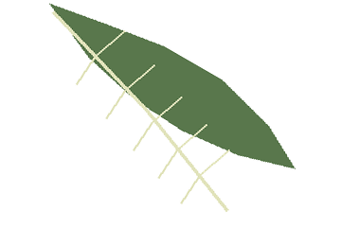
PLANT RX | M.SC. APPLIED DATA SCIENCE
Technologies Used
Model development
Data analysis
Image handling
Python
TensorFlow / Keras
Google Colab
NumPy
Pandas
Matplotlib / Plotly
Pillow
Backend
Frontend
FastAPI
Uvicorn
Pydantic
React
Vite
PLANT DISEASE DETECTION SYSTEM
12

Slide 14

PLANT RX | M.SC. APPLIED DATA SCIENCE
Results, Limitations and Future Work
Results
Challenges and limitations
Future enhancements
MobileNetV2: 97% reported
38 classes across 14 crops
Lightweight model chosen for practical serving
End-to-end concept: upload, predict, guidance
Only 38 known classes
Uneven class distribution
Mostly controlled dataset images
Reported results only
Real-world accuracy not verified
More field-captured images
Broader class coverage
Improved, consistent model testing
Validate backend end to end
Expert-reviewed guidance
Conclusion: PlantRx demonstrates a transfer-learning workflow with a guidance-oriented interface. Real-world validation is the next major step.
PLANT DISEASE DETECTION SYSTEM
14

Slide 15
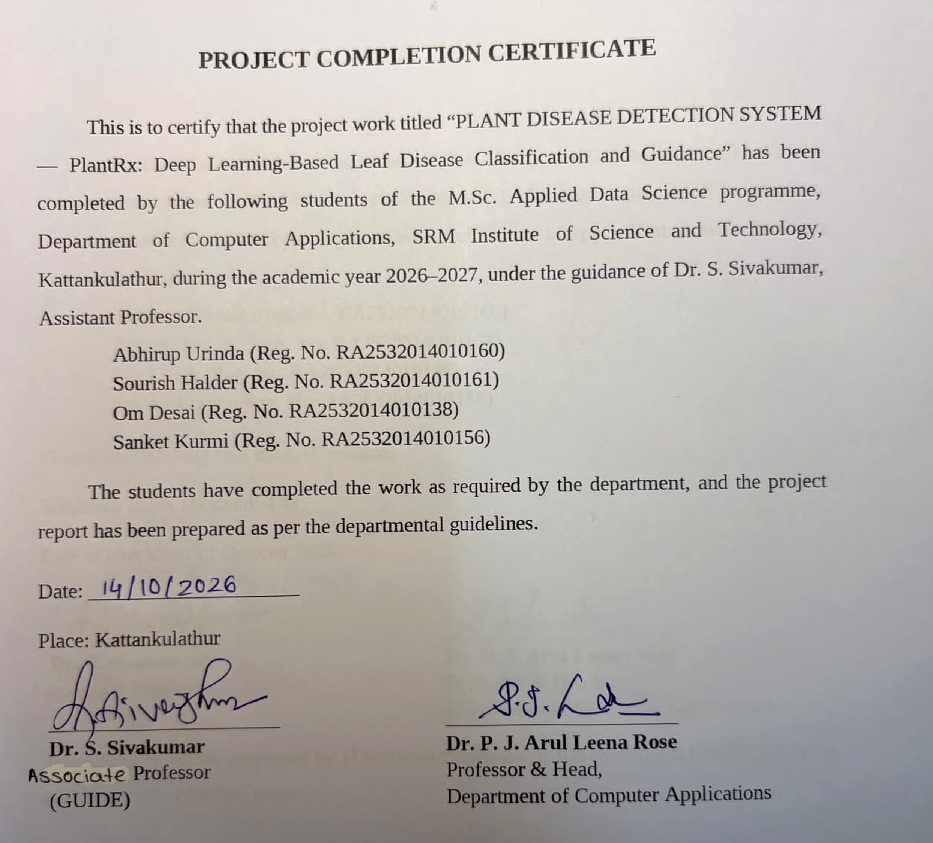

Slide 16

Thank You
Questions & Answers
PlantRx • Plant Disease Detection System
• M.Sc. Applied Data Science
Om Desai (RA2532014010138)
Sanket Kurmi (RA2532014010156)
Abhirup Urinda (RA2532014010160)
Sourish Haldar (RA2532014010161)

